Slide 1
Introduction to PL/SQL
CS 260

Slide 2
Topics
Definition and motivation
PL/SQL language basics
IF/THEN structures and loops
Using SQL commands in programs
Exception handling

Slide 3
What is a stored database program?
Program stored in the database and used to automate data processing
  Example: Calculate person's age based on retrieved DOB and current SYSDATE
Written using a procedural language extension specific to the DBMS:
  Oracle: PL/SQL
  SQL Server: T-SQL
  DB2: SQL PL
  MySQL: MySQL

Slide 4
Why create stored database programs?
To address the limitations of SQL commands
  Return results as a tabular result set and you might want different formatting
    Example: Student transcript
  No loops or IF/THEN structures in SQL
  You can only go so far with nested queries...

Slide 5
Why not write the programs in your application?
Stored program is accessible to multiple database schemas and applications
Language interfaces directly with the underlying database, so requires fewer program lines than comparable programs with embedded commands
Programs usually execute faster than programs with embedded commands
Security enforced by DBMS security model

Slide 6
Why you might avoid stored programs
Increases DBMS server's load
Language might lack flexibility of external programs
Might be more difficult to debug

Slide 7
Example PL/SQL Stored Program
CREATE OR REPLACE FUNCTION shopping_days_xmas
(current_date IN DATE)
RETURN NUMBER IS shopping_days NUMBER;
BEGIN
shopping_days :=
TO_DATE('25-DEC-2012', 'DD-MON-YYYY') - current_date;
RETURN shopping_days;
END;

Slide 8
Topics
Definition and motivation
PL/SQL language basics
IF/THEN structures and loops
Using SQL commands in programs
Exception handling

Slide 9
Types of PL/SQL Programs
Anonymous blocks
  Stand-alone programs that you submit to the SQL interpreter (just like a SQL command)
  Not persistent (not stored in the database)
Named program units
  Stored as database objects
  Can send and receive parameters

Slide 10
Basic PL/SQL Program Structure
DECLARE
  Variable declarations
BEGIN
  Program statements
EXCEPTION
  Error-handling statements
END;
Variable Declarations
Body
Exception
Section

Slide 11
PL/SQL Program Basics
Line of code may span multiple text editor lines
Each line ends with a semicolon
Text NOT cAse seNsitiVe
Comments:
  --single line
  /* block of comments */

Slide 12
Example Anonymous Block
  SET SERVEROUTPUT ON SIZE 4000;
DECLARE
todays_date DATE;
BEGIN
todays_date := SYSDATE;
DBMS_OUTPUT.PUT_LINE ('Today is ' ||
todays_date);
END;

Slide 13
PL/SQL Variables
Variable names must follow the Oracle naming standard
  You can use reserved words (BEGIN, NUMBER) and table names for variable names…bad idea
  Make variable names descriptive
Convention: Use lower-case letters and separate words with underscores
  Example: current_s_id

Slide 14
Declaring PL/SQL Variables
PL/SQL is a strongly-typed language
  All variables must be declared prior to use
Syntax for declaring a variable:
variable_name data_type_declaration;
current_s_id NUMBER(6);

Slide 15
Common PL/SQL Scalar Data Types
"Database" data types:
    VARCHAR2
    CHAR
    DATE
    LONG
    NUMBER
Additional (non-database) data types:
    Integers: BINARY_INTEGER, INTEGER, INT, SMALLINT, …
    Reals: DEC, DECIMAL, DOUBLE, PRECISION, NUMERIC, REAL, …
    BOOLEAN

Slide 16
PL/SQL Composite Data Types
RECORD
TABLE
Table of records
You would populate these using a database query, then manipulate them in your stored program…

Slide 17
Reference Data Types
%TYPE: assumes the data type of a database field
%ROWTYPE: creates a record data type that assumes the data type of a database record
curr_cust_name candy_customer.cust_name%TYPE;
[SQL query] query_result%ROWTYPE;

Slide 18
Basic Operators
Example
Result
Exponentiation | **
Multiplication | *
Division | /
Addition/Subtraction | +/-
Assignment | :=
Comparison | =
Concatenation | ||

Slide 19
Displaying PL/SQL Output When Testing Blocks
Command to activate memory buffer in command-line SQL programs to enable PL/SQL program output:
  SQL> SET SERVEROUTPUT ON SIZE buffer_size;
  SQL> SET SERVEROUTPUT ON SIZE 4000;

Slide 20
Displaying PL/SQL Program Output
Command to output data from a PL/SQL program:
  DBMS_OUTPUT.PUT_LINE('output string');
  DBMS_OUTPUT.PUT_LINE('Current Output:');

Slide 21
Topics
Definition and motivation
PL/SQL language basics
IF/THEN structures and loops
Using SQL commands in programs
Exception handling

Slide 22
IF/THEN/ELSE
IF condition THEN
statements;
ELSE
alternate statements;
END IF;

Slide 23
Example IF/THEN/ELSE Program
DECLARE
today VARCHAR2(15);
BEGIN
today := TO_CHAR(SYSDATE, 'Day');
IF (today = 'Friday') THEN
DBMS_OUTPUT.PUT_LINE
('Today is Friday :-)');
ELSE
DBMS_OUTPUT.PUT_LINE
('Today is not Friday :-(');
END IF;
END;

Slide 24
IF/ELSIF ladder (notice spelling):
IF condition THEN
statements;
ELSIF condition THEN
statements;
ELSIF condition THEN
statements;
...
ELSE
statements;
END IF;

Slide 25
PL/SQL Loops
LOOP ...EXIT WHEN
WHILE ... LOOP
LOOP
statements;
EXIT WHEN condition;
END LOOP;
Post-test loop
WHILE condition
LOOP
statements;
END LOOP;
Pretest loop

Slide 26
PL/SQL Loops
Numeric FOR
FOR counter IN startValue .. endValue
LOOP
statements;
END LOOP;

Slide 27
Example Looping Program
--create a table to store current years' dates
CREATE TABLE dates_2012
(date_id NUMBER(4), date_value DATE);
--anonymous block to insert all years' dates
DECLARE
curr_date DATE :=
TO_DATE('01-JAN-2012', 'DD-MON-YYYY');
BEGIN
FOR counter IN 1 .. 366
LOOP
INSERT INTO dates_2012 VALUES(counter, curr_date);
curr_date := curr_date + 1;
END LOOP;
END;

Slide 28
Topics
Definition and motivation
PL/SQL language basics
IF/THEN structures and loops
Using SQL commands in programs
Exception handling

Slide 29
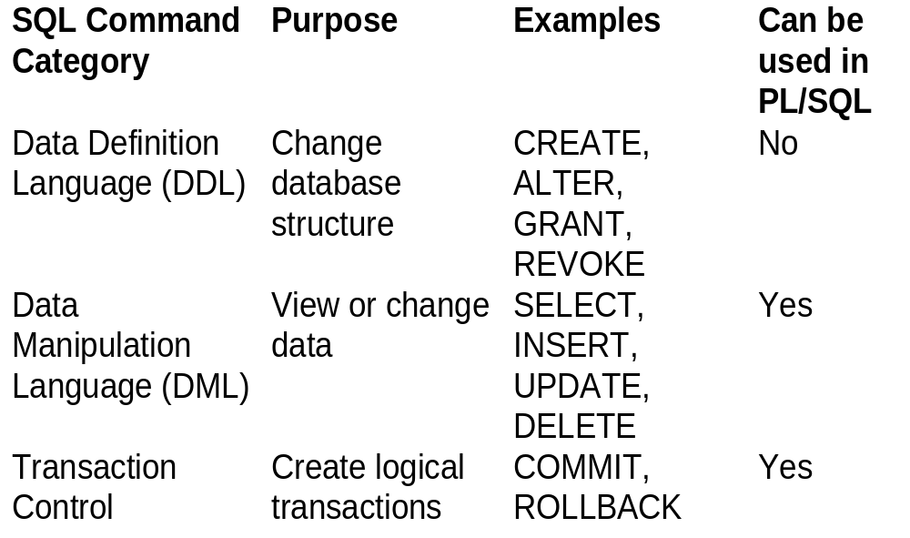
Using SQL Commands in PL/SQL Programs

Slide 30
Using SELECT Commands in PL/SQL Programs
When you retrieve records in a PL/SQL program, the program must be able to reference the retrieved values
To do this, you must create a cursor
  Current set of records
  Pointer to a server memory location called the context area

Slide 31
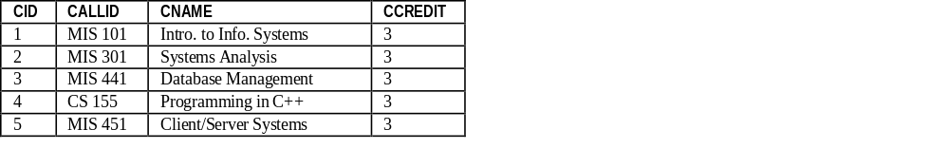
Cursors
Database Server Memory
Cursor
Number of rows processed
Parsed command
statement
context
area
active set

Slide 32
Cursor Processing
Process a cursor sequentially using a loop
Uses a pointer to point to the current record

Slide 33
Types of Cursors
Implicit
Explicit

Slide 34
Implicit Cursor
Doesn’t need to be declared
Can be used to assign the output of a SELECT command to one or more variables
Created automatically every time you execute an INSERT, UPDATE, or DELETE
Can only be used for a SELECT query if the query returns one and only one record

Slide 35
Implicit Cursor Syntax
SELECT field1, field2, …
INTO variable1, variable2, …
FROM tablename
WHERE search_condition_that_returns_a_single_record;

Slide 36
Implicit Cursor Example
SET SERVEROUTPUT ON SIZE 4000;
DECLARE
curr_cust_name
candy_customer.cust_name%TYPE;
curr_cust_add
candy_customer.cust_addr%TYPE;
BEGIN
SELECT cust_name, cust_addr
INTO curr_cust_name, curr_cust_add
FROM candy_customer
WHERE cust_id = 1;
DBMS_OUTPUT.PUT_LINE(curr_cust_name);
DBMS_OUTPUT.PUT_LINE(curr_cust_add);
END;

Slide 37
Implicit Cursor Usage
Handy when you want to quickly retrieve a single value and use it…
… but is only good for a very limited case (1 and only 1 record result)
DECLARE
num_customers NUMBER(5);
BEGIN
SELECT count(*)
INTO num_customers
FROM candy_customer;
DBMS_OUTPUT.PUT_LINE(num_customers);
END;

Slide 38
Explicit Cursors
  Can be used if query returns one record, multiple records, or no records
  Must be declared in program DECLARE section
  Results must be processed using a loop

Slide 39
Using an Explicit Cursor
Declare the cursor
Open the cursor
Fetch the cursor result into PL/SQL program variables
Close the cursor

Slide 40
Explicit Cursor Syntax Example
SET SERVEROUTPUT ON SIZE 4000;
DECLARE
CURSOR customer_cursor IS
SELECT cust_id, cust_name FROM candy_customer;
curr_id candy_customer.cust_id%TYPE;
curr_name candy_customer.cust_name%TYPE;
BEGIN
OPEN customer_cursor;
LOOP
FETCH customer_cursor INTO curr_id, curr_name;
EXIT WHEN customer_cursor%NOTFOUND;
DBMS_OUTPUT.PUT_LINE(curr_id || ' ' || curr_name);
END LOOP;
CLOSE customer_cursor;
END;
Declare the cursor
Open the cursor
Fetch the row
Close the cursor

Slide 41
Explicit Cursor - Alternate Syntax Using %ROWTYPE
SET SERVEROUTPUT ON SIZE 4000;
DECLARE
CURSOR customer_cursor IS
SELECT cust_id, cust_name FROM candy_customer;
curr_cust_row customer_cursor%ROWTYPE;
BEGIN
OPEN customer_cursor;
LOOP
FETCH customer_cursor INTO curr_cust_row;
EXIT WHEN customer_cursor%NOTFOUND;
DBMS_OUTPUT.PUT_LINE(curr_cust_row.cust_id || ' ' || curr_cust_row.cust_name);
END LOOP;
CLOSE customer_cursor;
END;

Slide 42
Alternative Processing Approach for an Explicit Cursor
Cursor FOR Loop
  Special loop just for processing explicit cursors
    Automatically opens, processes, and closes the cursor
    Automatically terminates after all cursor records are processed
  Makes your code much shorter!

Slide 43
Cursor FOR Loop Example
SET SERVEROUTPUT ON SIZE 4000;
DECLARE
CURSOR customer_cursor IS
SELECT cust_id, cust_name FROM candy_customer;
customer_row customer_cursor%ROWTYPE;
BEGIN
FOR customer_row IN customer_cursor
LOOP
--process each row
DBMS_OUTPUT.PUT_LINE(customer_row.cust_id || ' ' || customer_row.cust_name);
END LOOP;
END;

Slide 44
Creating Master-Detail Cursors
Example: output all customer names and their associated purchases:
Armstrong, Inc.
*****28-OCT-04***Mystery Melange***3.7
Bobby Bon Bons
*****29-OCT-04***Celestial Cashew Crunch***3.7
*****29-OCT-04***Unbrittle Peanut Paradise***1.2
*****29-OCT-04***Mystery Melange***4.4
*****29-OCT-04***Unbrittle Peanut Paradise***3
Columberg Sweets
*****29-OCT-04***Unbrittle Peanut Paradise***14
*****29-OCT-04***Nuts Not Nachos***4.8
Montag, susie
*****28-OCT-04***Celestial Cashew Crunch***2
*****28-OCT-04***Mystery Melange***3.7
…

Slide 45
Approach:
Use nested blocks
  "Master" cursor in outer block, "detail" cursor in inner block
Create a variable in the outer block to specify the search condition for the inner block
Don't use a cursor FOR loop for processing the outer cursor!

Slide 46
Master Block Code
Inner block
code
DECLARE
--retrieve IDs of customers who have made purchases
CURSOR customer_cursor IS
SELECT DISTINCT cu.cust_id, cust_name
FROM candy_customer cu JOIN candy_purchase pu
ON cu.cust_id = pu.cust_id
ORDER BY cust_name;
cust_row customer_cursor%ROWTYPE;
--variable to specify search condition for inner block
curr_cust_id candy_customer.cust_id%TYPE;
BEGIN
OPEN customer_cursor;
LOOP
FETCH customer_cursor INTO cust_row;
EXIT WHEN customer_cursor%NOTFOUND;
DBMS_OUTPUT.PUT_LINE('');
DBMS_OUTPUT.PUT_LINE(cust_row.cust_name);
curr_cust_id := cust_row.cust_id;
END LOOP;
CLOSE customer_cursor;
END;

Slide 47
Inner Block Code:
search condition
from outer block
DECLARE
--retrieve related purchase information
CURSOR purchase_cursor IS
SELECT purch_date, delivery_date, prod_desc, pounds
FROM candy_purchase pu JOIN candy_product pr
ON pu.prod_id = pr.prod_id
WHERE cust_id = curr_cust_id;
purch_row purchase_cursor%ROWTYPE;
BEGIN
FOR purch_row IN purchase_cursor
LOOP
DBMS_OUTPUT.PUT_LINE('*****' || purch_row.purch_date || '***' || purch_row.prod_desc || '***' || purch_row.pounds);
END LOOP;
END;

Slide 48
Topics
Definition and motivation
PL/SQL language basics
IF/THEN structures and loops
Using SQL commands in programs
Exception handling

Slide 49
PL/SQL Exception Handling
Exception:
  Runtime error condition
    Example: divide by 0, retrieve multiple records into an implicit query
  Event that violates a business rule not constrainable by the database
    Delivery dates should not be before purchase dates
Strategy:
  "Handle" the condition

Slide 50
Sequential Program Flow With and Without Exception Handling
without
with
Program Body
Program Body
error occurs;
execution
immediately
goes to:
error occurs
Exception handlers
System displays
a default error message
and program immediately
terminates
System displays a
custom error message
Program optionally
executes
additional statements

Slide 51
Types of Exceptions in PL/SQL Programs
Predefined (Named)
  Most common system errors have built-in NAMED exception handlers
Undefined (Unnamed)
  Less common system errors
  Built-in exception handler is associated with the ORA- error code number
User-defined
  Handle application-specific errors (business rules)

Slide 52
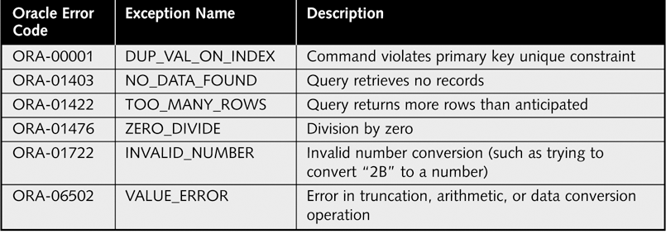
Common PL/SQL Named Exceptions
http://download.oracle.com/docs/cd/B13789_01/appdev.101/b10807/07_errs.htm#i9355

Slide 53
Example Exception Handler for a Named Exception
SET SERVEROUTPUT ON SIZE 4000;
DECLARE
curr_cust_id candy_customer.cust_id%TYPE;
curr_cust_name candy_customer.cust_name%TYPE;
BEGIN
SELECT cust_name
INTO curr_cust_name
FROM candy_customer;
DBMS_OUTPUT.PUT_LINE(curr_cust_name);
EXCEPTION
WHEN TOO_MANY_ROWS THEN
DBMS_OUTPUT.PUT_LINE('Change your query so it'
|| ' retrieves only one record');
END;

Slide 54
Example Exception Handler for a Un-named Exception
SET SERVEROUTPUT ON SIZE 4000;
DECLARE
new_candy_product_id candy_product.prod_id%TYPE := 100;
BEGIN
--update an FK value using a non-existent value
UPDATE candy_purchase
SET prod_id = new_candy_product_id
WHERE purch_id = 1;
EXCEPTION
-- ...named exception handlers
WHEN OTHERS THEN
IF SQLCODE = -2291 THEN
DBMS_OUTPUT.PUT_LINE('Product ID ' ||
new_candy_product_id || ' does not exist.');
DBMS_OUTPUT.PUT_LINE('Message: ' || SQLERRM );
END IF;
END;

Slide 55
User-Defined Exceptions
For catching errors that you can't (or don't want) to enforce using database constraints
Approach: write code to test for the condition and then write an associated exception handler

Slide 56
Example Exception Handler for a User-Defined Exception
SET SERVEROUTPUT ON SIZE 4000;
DECLARE
curr_purch_id candy_purchase.purch_id%TYPE := 1;
curr_purch_date candy_purchase.purch_date%TYPE;
new_delivery_date DATE := TO_DATE('1/1/2000', 'MM/DD/YYYY');
e_invalid_date EXCEPTION;
BEGIN
SELECT purch_date INTO curr_purch_date FROM candy_purchase
WHERE purch_id = curr_purch_id;
IF curr_purch_date <= new_delivery_date THEN
UPDATE candy_purchase SET delivery_date = new_delivery_date
WHERE purch_id = curr_purch_id;
ELSE
RAISE e_invalid_date;
END IF;
COMMIT;
EXCEPTION
WHEN e_invalid_date THEN
DBMS_OUTPUT.PUT_LINE('Delivery date cannot be before purchase date, please change it');
END;
http://www.devshed.com/c/a/Oracle/Database-Interaction-with-PLSQL-User-defined-Exceptions-Nested-Blocks/

Slide 57
Exception Scope & Propagation
Exception handlers only handle exceptions in their BEGIN/END block
You can create nested blocks so outer block execution isn't impacted by inner block exceptions
  After an exception is raised and handled, all currently-uncommitted transactions are rolled back
  Execution resumes in the outer block

Slide 58
Nested Block Example
DECLARE
Outer block declarations
BEGIN
Outer block statements
  DECLARE
  Inner block declarations
  BEGIN
  Inner block statements
  EXCEPTION
  Inner block exception handlers
  END;
More outer block statements;
EXCEPTION
Outer block exception handlers
END;

